Slide 1
Computer Animation

Slide 2
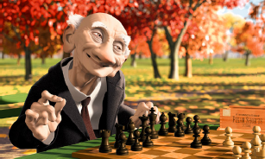
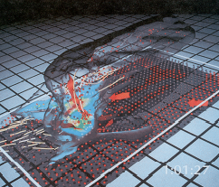
Computer Animation
What is Animation?
Make objects change over time according to scripted actions
What is Simulation?
Predict how objects change over time according to physical laws

Slide 3
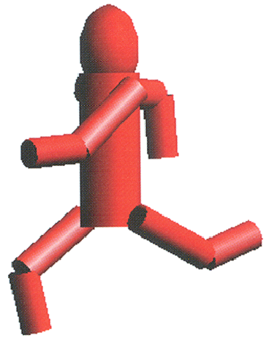
Outline
Principles of Animation
Keyframe Animation
Articulated Figures

Slide 4
Principle of Traditional Animation – Disney –
Squash and Stretch
Slow In and Out
Anticipation
Exaggeration
Follow Through and Overlapping Action
Timing
Staging
Straight Ahead Action and Pose-to-Pose Action
Arcs
Secondary Action
Appeal

Slide 5
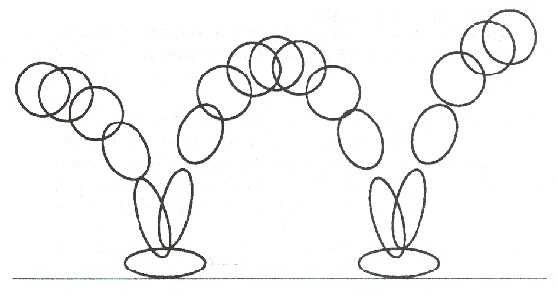
Squash and Stretch
Stretch
Squash

Slide 6
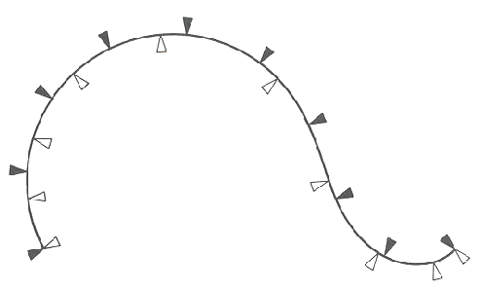
Slow In and Out

Slide 7
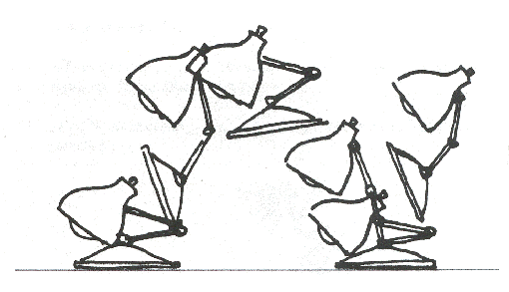
Anticipation

Slide 8
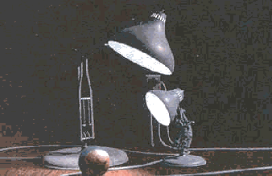
Computer Animation
Animation Pipeline
3D modeling
Motion specification
Motion simulation
Shading, lighting, & rendering
Postprocessing

Slide 9
Outline
Principles of Animation
Keyframe Animation
Articulated Figures

Slide 10
Keyframe Animation
Define Character Poses at Specific Time Steps Called “Keyframes”

Slide 11
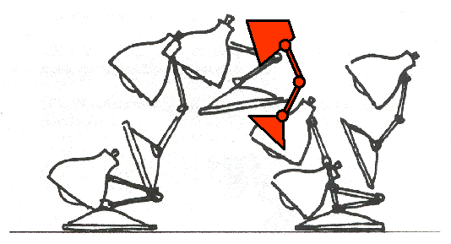
Keyframe Animation
Interpolate Variables Describing Keyframes to Determine Poses for Character in between

Slide 12
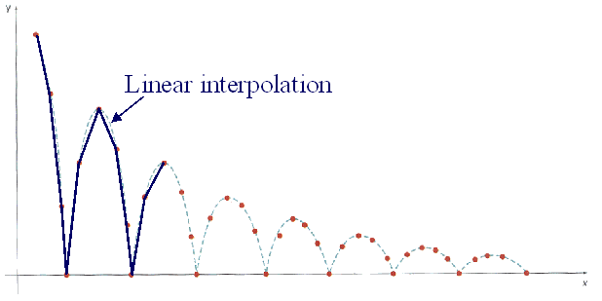
Inbetweening
Linear Interpolation
Usually not enough continuity

Slide 13
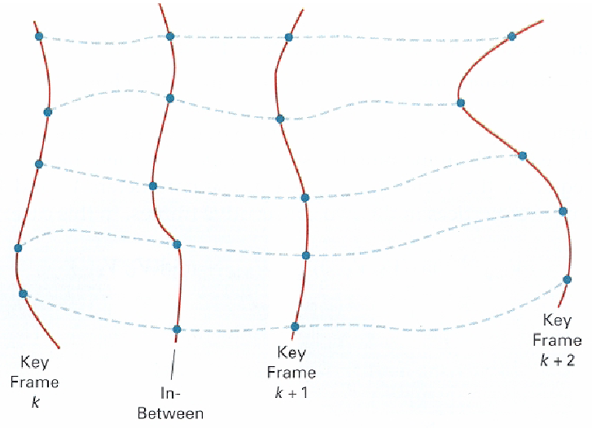
Inbetweening
Spline Interpolation
Maybe good enough

Slide 14
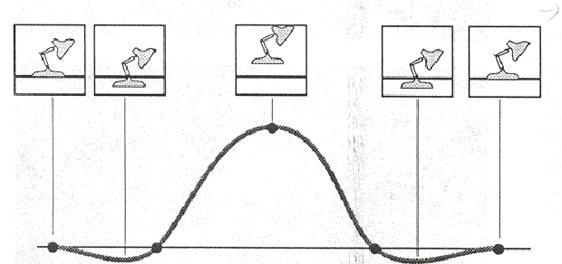
Inbetweening
Spline Interpolation
Maybe good enough
May not follow physical laws

Slide 15
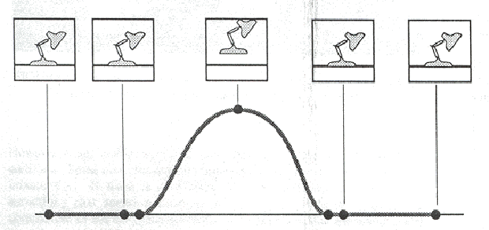
Inbetweening
Spline Interpolation
Maybe good enough
May not follow physical laws

Slide 16
Outline
Principles of Animation
Keyframe Animation
Articulated Figures

Slide 17
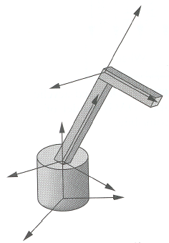
Articulated Figures
Character Poses Described by Set of Rigid Bodies Connected by “Joints”
Base
Arm
Hand
Scene Graph

Slide 18
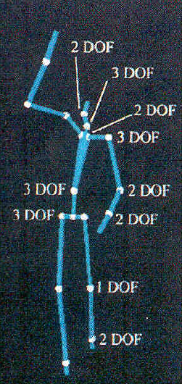
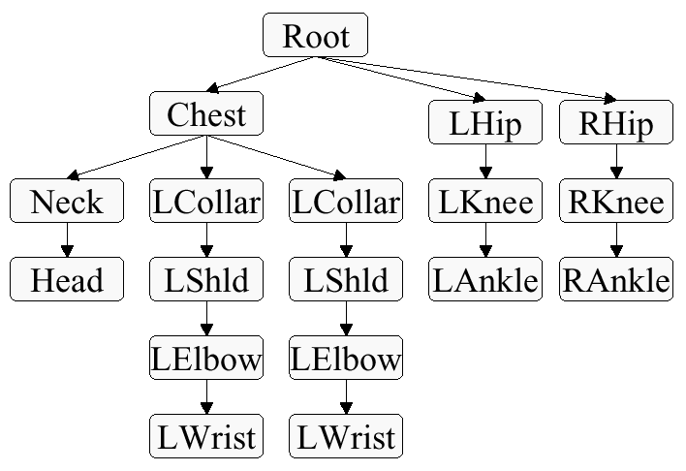
Articulated Figures
Well-Suited for Humanoid Characters
R
R
R
R

Slide 19
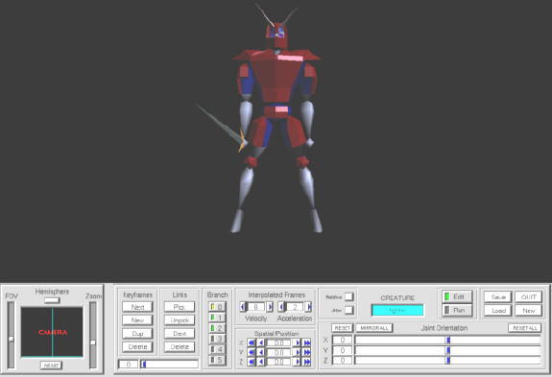
Articulated Figures
Joints Provide Handles for Moving Articulated Figure

Slide 20
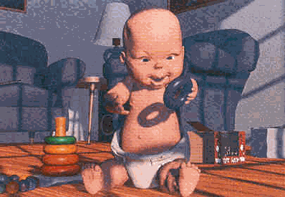
Summary
Animation Requires ...
Modeling
Scripting
Inbetweening
Lighting, shading
Rendering
Image processing

Slide 21
Motion Capture
Motion capture = Motion tracking = Mocap
Process of recording movement and translating the movement onto a digital model
To animate digital character models in 3D animation
Records actions of human actors, and use the information gathered

Slide 22
Motion Capture
Motion of an actor can be captured with various methods
Markers
Without Markers (Optical)
Mechanical motion
Magnetic system

Slide 23
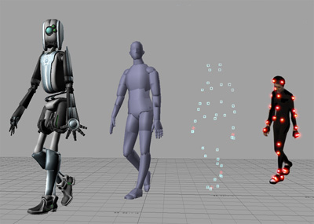
Motion Capture
Application
Military training simulations
Video games
Films
Sports
Medical applications

Slide 24
Motion Capture
Advantages
Can replace key-frame based animation with smoother animation with much less efforts
Recording various test animations can be performed without much concern
Complex, and physically accurate animation

Slide 25
Motion Capture
Disadvantages
Special hardware & software are required
Required software, hardware and personnel can be expensive
Motions which are not physically correct cannot be or are hard to be captured

Slide 26

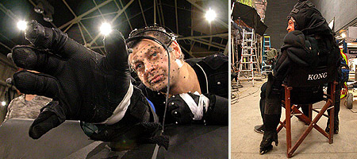
Motion Capture
King Kong, 2005

Slide 27
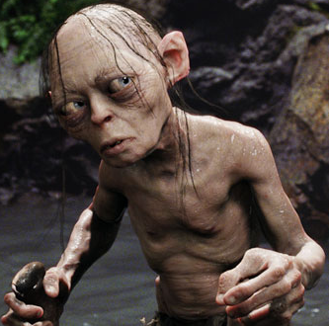
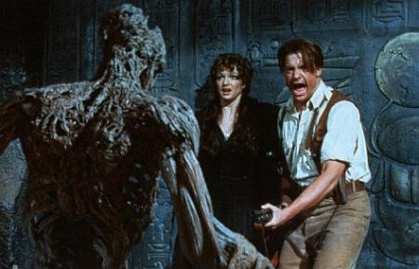
Motion Capture
The Lord of The Rings,
2001 ~ 2003
The Mummy, 1999

Slide 28
Overview of Kinematics & Dynamics
Kinematics
Consider only motion
Determined by positions, velocities, accelerations
Dynamics
Consider underlying forces
Compute motion from initial conditions and physics

Slide 29
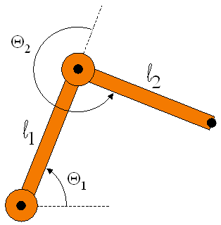
Example: 2-Link Structure
Two Links Connected by Rotational Joints
“End-Effector”
X=(x, y)
(0, 0)

Slide 30
Forward Kinematics
Animator Specifies Joint Angles: Θ₁ and Θ₂
Computer Finds Positions of End-Effector: X
X=(x, y)
(0, 0)

Slide 31
Inverse Kinematics
What If Animator Knows Position of “End-Effector”
Animator Specifies End-Effector Positions: X
Computer Finds Joint Angles: Θ₁ and Θ₂
“End-Effector”
X=(x, y)
(0, 0)

Slide 32
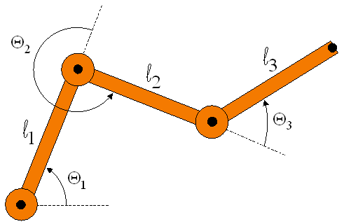
Inverse Kinematics
Problem for More Complex Structures
System of equations is usually under-defined
Multiple solutions
X=(x, y)
(0, 0)
Three unknowns: Θ₁, Θ₂, Θ₃
Two equations: x, y

Slide 33
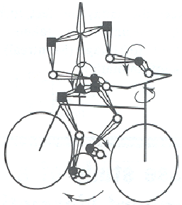
Summary
Forward Kinematics
Specify conditions (joint angles)
Compute positions of end-effectors
Inverse Kinematics
“Goal-directed” motion
Specify goal positions of end effectors
Compute conditions required to achieve goals
Inverse kinematics provides easier specification for many animation tasks, but it is computationally more difficult

